Slide 1
vaping
By: Nathan Barrios

Slide 2
What is vaping?
Vaping as by the standard definition is breathing and breathing out vapor from an e cigarette or something like an e cigarette.
Vaping is made possible by nicotine solutions that when heated up, makes vapor, hence the word(s) vape/ vaping.

Slide 4
Where can you get electronic cigarettes?
Electronic cigarettes are available by being purchased at a gas station or a convenience store.
They are highly easy to acquire and have a very small amount or no nicotine at all in the solutions.

Slide 5
Why are they so popular?
They are much cheaper than regular cigarettes and come in flavors too, which is another reason why they are so popular among teens and young adults.
They come in many looks too so teens can customize their e cigarettes anyway they want to.

Slide 6
Is it harmful?
There is roughly 17% of high school student’s vaping, as opposed to 14% smoking, because they say its less harmful.
Vaping is way less harmful, a surgeon-general, said that its brings the burns that are cause by regular cigarettes and causes way less deaths than with regular cigarettes.

Slide 7
Legal issues
You have to be eighteen or older to buy an electronic cigarette which can be a problem
More and more teens are buying/ getting electronic cigarettes at a younger and younger age.

Slide 8
addiction
There actually is no real bad side fro vaping when it comes to addiction, its actually used to get people to stop regularly smoking regular cigarettes.
Vaping is really easy to put down and pick up whenever you feel like vaping.

Slide 9
Street names for e cigarettes
Hookah pens
E-hookahs
Vape pipes
Vape pen
Vape
E-cig

Slide 10
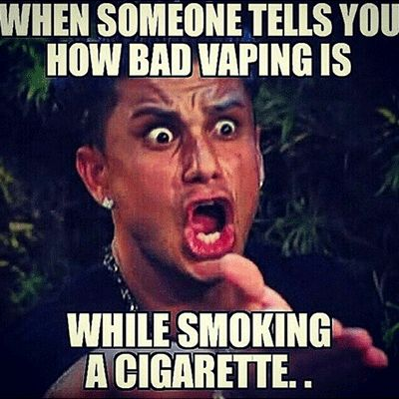
Long term and short term effects
Vaping isn’t really that harmful to you, at least not nearly as much as regular cigarettes are, regular cigarettes burn people’s lung and make them black from the smoke that it produces, vapes don’t burn your lungs or even make smoke, it doesn’t really have a long term effect or a short term effect doctors even recommend it to people who want to stop smoking but need a substitute.

Slide 11
Works cited
https://theconversation.com/so-your-teenager-is-vaping-e-cigarettes-should-you-worry-36398?gclid=CK6iy4_v8dMCFRu5wAodlI0JcQ

